Slide 1
CSCI 473 MPI00
Lakota Dolce

Slide 2
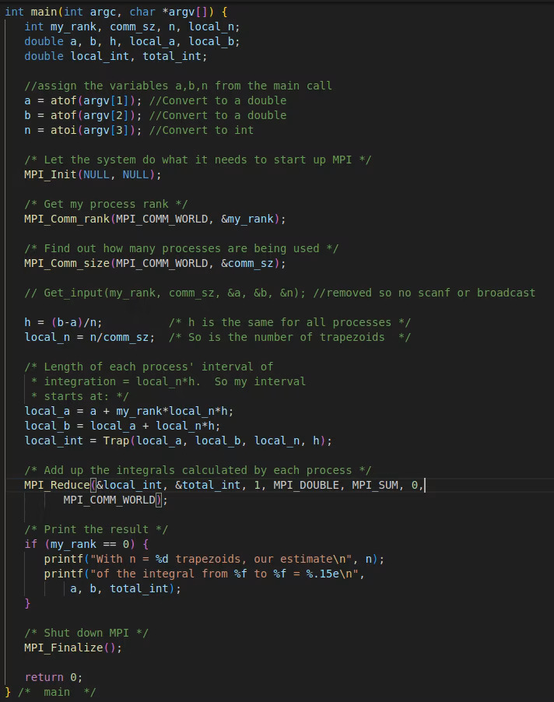
First steps
1.
Remove function call for getInput - Can’t use scanf or B-Cast
2.
Modify the main function to have argc and argv - accept arguments from the cli
3.
Reassign variables a, b, n - have to assign the variables since not using the getInput function

Slide 3
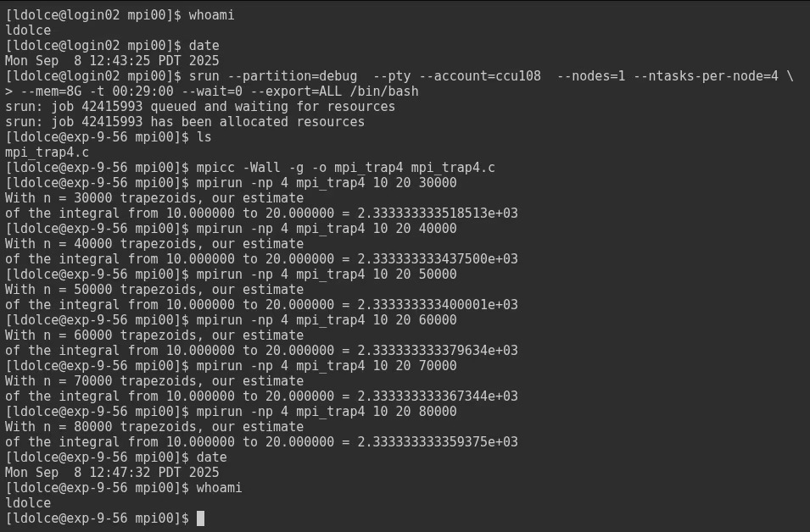
Steps for Expanse
Login and Job request

Slide 4
Steps for Expanse
Compiling and running:

Slide 5
Steps for Expanse
Running and Returns

